Slide 1
Seminar: FEB 2020
Mayank Singh, 17426 (ECE)

Slide 2
Topics I wanted to cover in seminar
Engineering
Electronics
Productivity
Common Misconceptions
Abstract Topics
Presentation
Fun

Slide 3
My Topic: How to build a project (with example)
Best method, complete guide to building project

Slide 4
WHY ?
WHY ?
WHY ?
WHY ?
WHY ? Build a project

Slide 5




Slide 6

The one who understands debugging, knows how the things work
-Mayank Singh

Slide 7
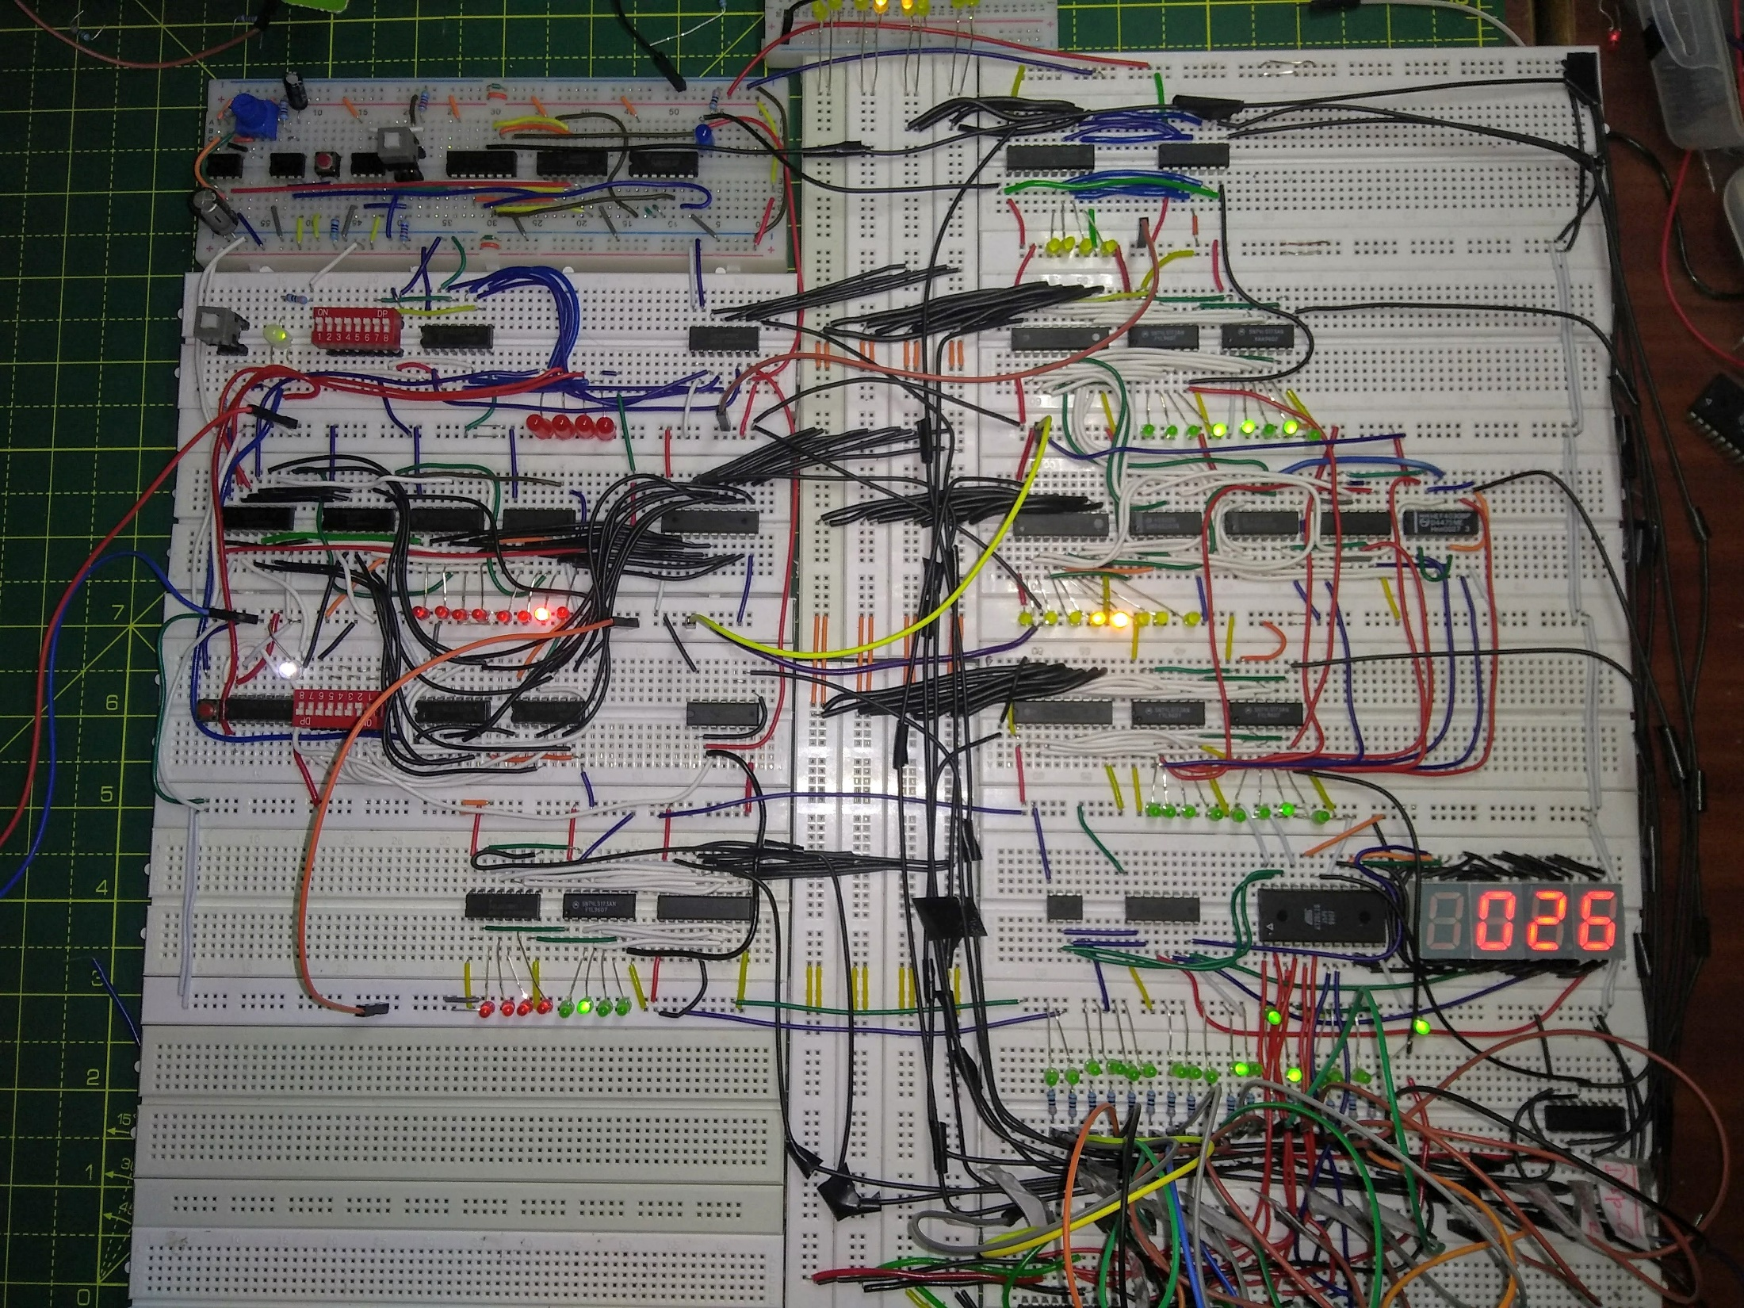

Slide 8
How to Start?
Anything, from anywhere

Slide 9
Just some random charts nothing new
Minority
Majority

Slide 10
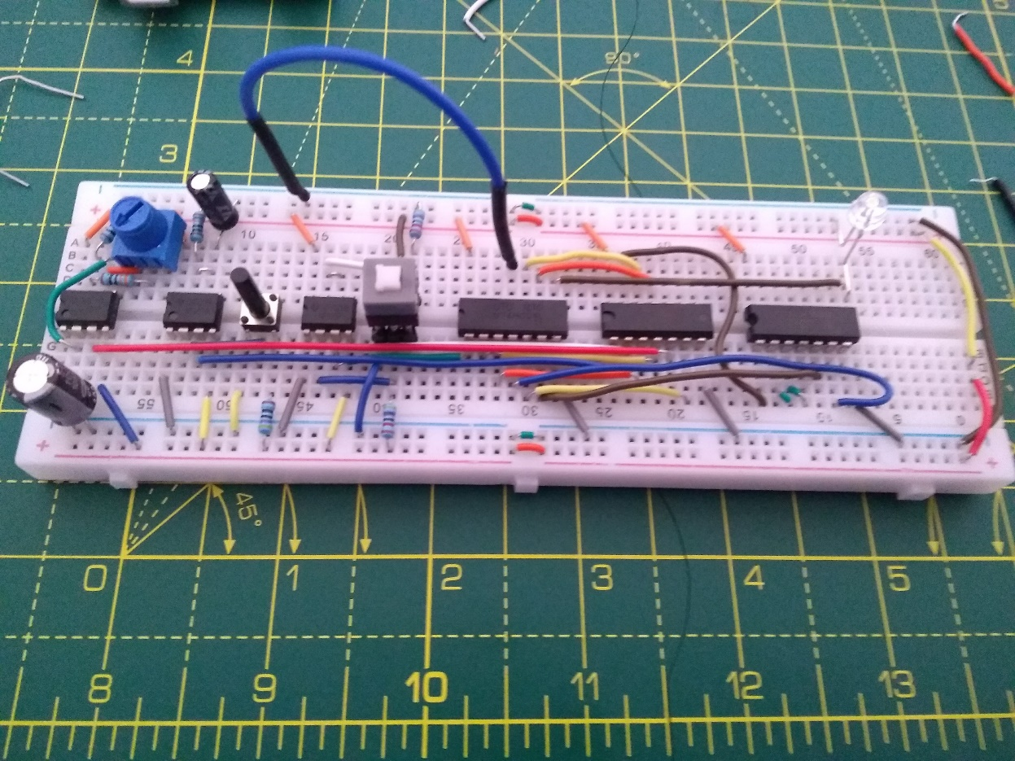
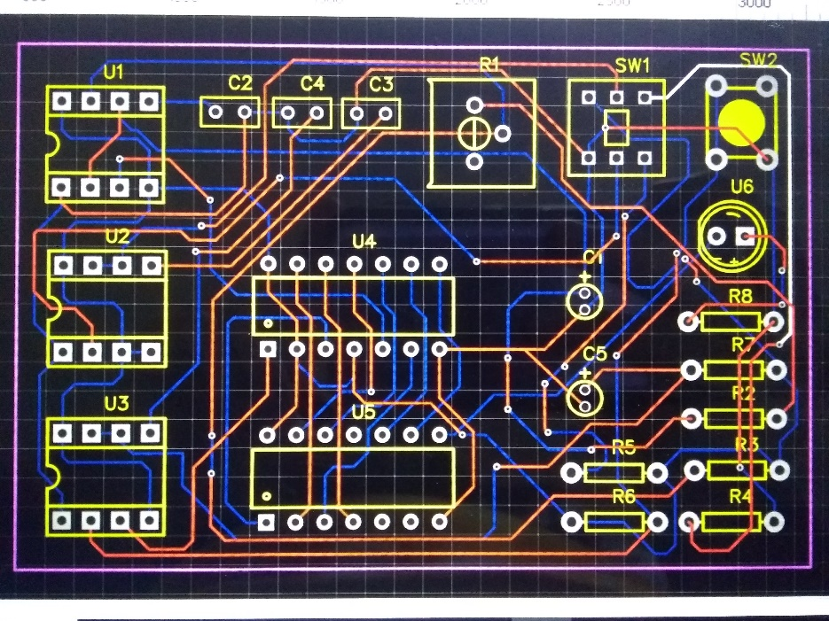
Pseudo Project
Find new ways to do it
Understand the technology
Find recent techniques to do it
Get to know what is going on in that technology
Complete the project and connect it with your new project
Fig. Clock module
Fig. Clock module PCB

Slide 11
“FLOW”

Slide 12
Topics to choose
IoT
Automation

Slide 13
Common Misconception
IoT vs Automation

Slide 14
Topics to choose
IoT
Automation
Electronics
Microprocessor
Hardware related
Do it for competition

Slide 15
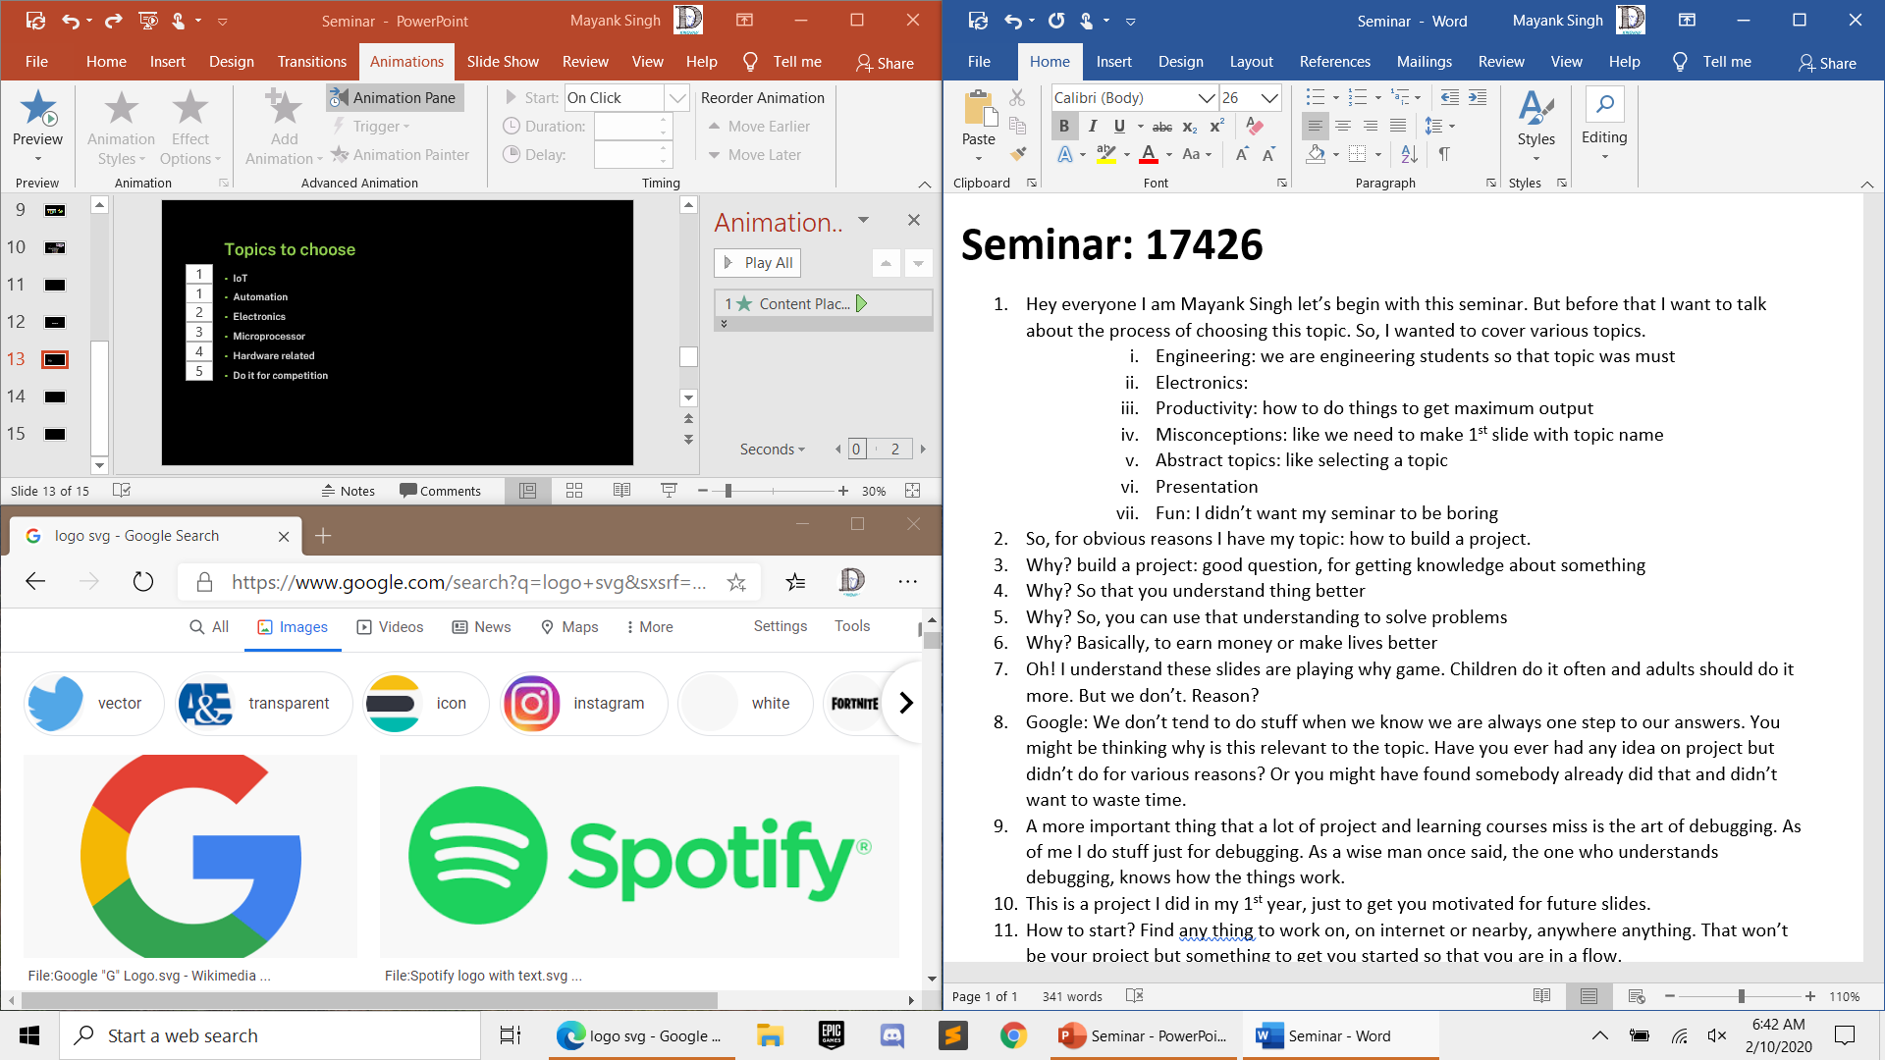
My Pseudo project

Slide 16
Main Project

Slide 17
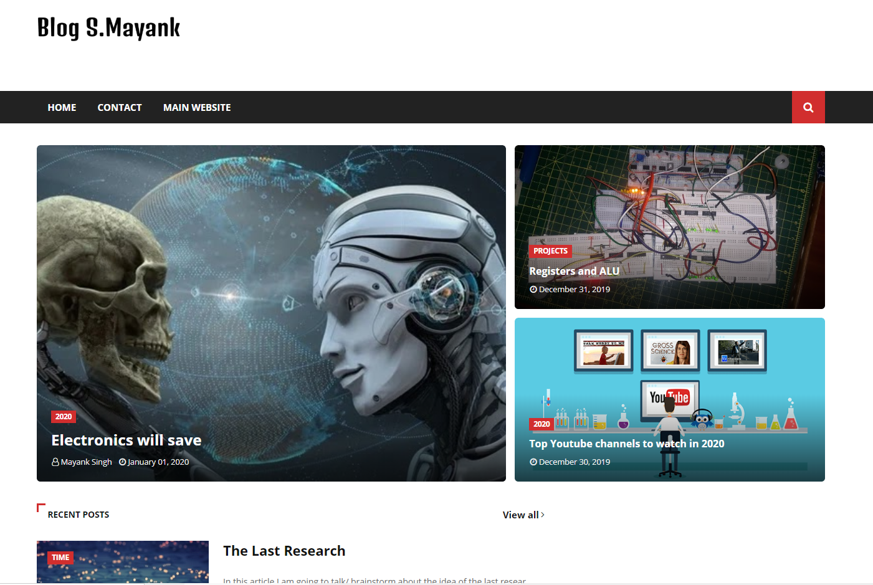
My Main project
#AD

Slide 18



